Slide 1
Weed community composition and waterhemp population dynamics in simple and more diverse cropping systems suitable for the Midwestern USA
Huong Nguyen
October 3rd, 2022

Slide 2
Acknowledgments
POS committee: Drs. Matt Liebman, Mark Gleason, Philip Dixon, Lisa Schulte-Moore, and Mike Owen.
The Liebman research group, ISU Agronomy Research Farm, and Seed Science Lab
The graduate program in Sustainable Agriculture, the Department of Agronomy, and the Department of Statistics Consulting
Friends and family
Henry A. Wallace Chair for Sustainable Agriculture, Robert A. Sloan, and Gary and Ann Holck scholarships for Sustainable Agriculture

Slide 3
Dissertation organization
Weed community composition in simple and more diverse cropping systems
Impact of cropping system diversification on vegetative and reproductive characteristics of waterhemp
Effects of crop rotation on common waterhemp population dynamics: prospective and retrospective analyses
Notes:
My dissertation has 3 data chapters

Slide 4
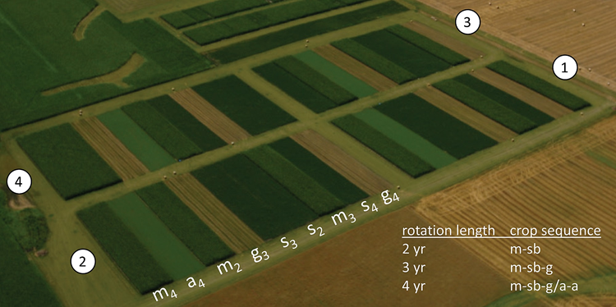
Photo: Matt Liebman
Notes:
An RCBD with 4 replications

Slide 5
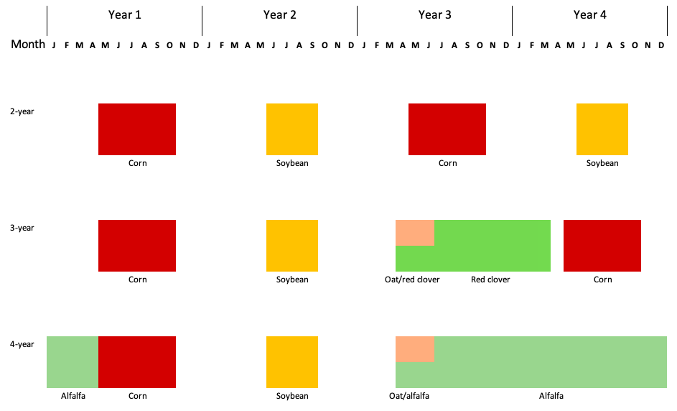


Rotation
Notes:
No herbicide was applied in oat/red clover and alfalfa
Corn and soybean received 2 herbicide regimes up to 2016
From 2017, corn continued to receive 2 herbicide regimes, soybean 1
Arrows represent tillage timing and methods

Slide 6
Weed community composition in simple and more diverse cropping systems
How did rotation system and corn weed management affect crop yields?
How did rotation system, crop species, and corn weed management affect community ecological indices?
How did rotation, crop species, and corn weed management affect weed community density and growth?
How did rotation, crop species, and corn weed management affect individual weed species abundance?
@FrontAgro
https://doi.org/10.3389/fagro.2022.848548
Notes:
Crop yields were used to evaluate the effectiveness of contrasting weed management programs: no difference in yields suggests no difference in effectiveness

Slide 7
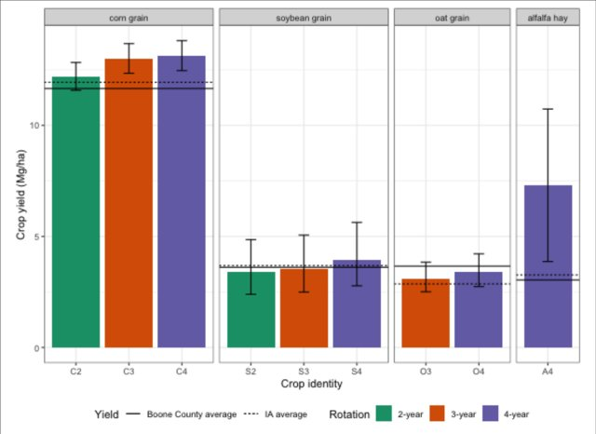
Tolerating a higher abundance of weeds can save a substantial amount of herbicide a.i.
 | Conventional herbicide | Low herbicide
2-year | -0% | -13%
3-year | -33% | -42%
4-year | -50% | -57%
Notes:
Abbreviations: Species followed by rotation length. This coding is consistent throughout this presentation
Question: How did rotation system and corn weed management affect crop yields?
No yield difference, C4, A4 higher than county and state avg

Slide 8
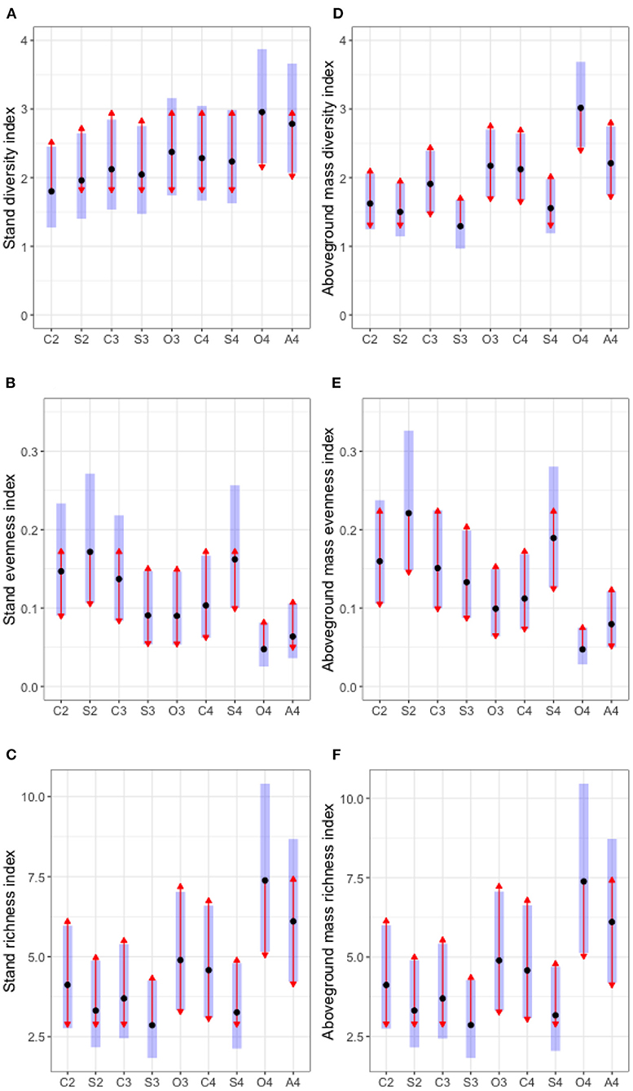
The diversity and richness indices are higher in the cool-season crops. The evenness index was lower in the cool-season crops.
Notes:
Q: How did rotation system, crop species, and corn weed management affect community ecological indices?
Diversity, richness, and evenness should be used together to paint a complete picture, especially because of high elasticity in individual plant size of weeds. Example: 1 in vs 6ft waterhemp can be at the same physiological maturity.

Slide 9
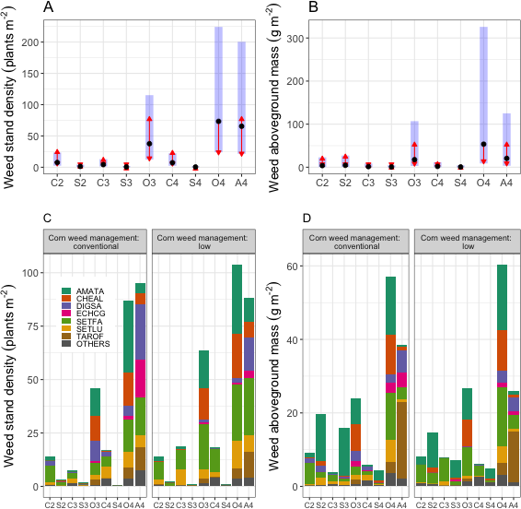
Aggressive weed species’ abundance was lower in the more diverse cropping systems.
Notes:
Q: How did rotation, crop species, and corn weed management affect weed community density and growth?
Further:
How did rotation, crop species, and corn weed management affect individual weed species abundance?

Slide 10
Impact of cropping system diversification on vegetative and reproductive characteristics of waterhemp
The population aboveground mass, density, and sex ratio
The relationship between waterhemp's female size and fecundity
@FrontAgro https://doi.org/10.3389/fagro.2022.811359
Notes:
Context: when the weed grew in association with five crop species (corn, soybean, oat, red clover, and alfalfa) arranged in three rain-fed cropping systems

Slide 11
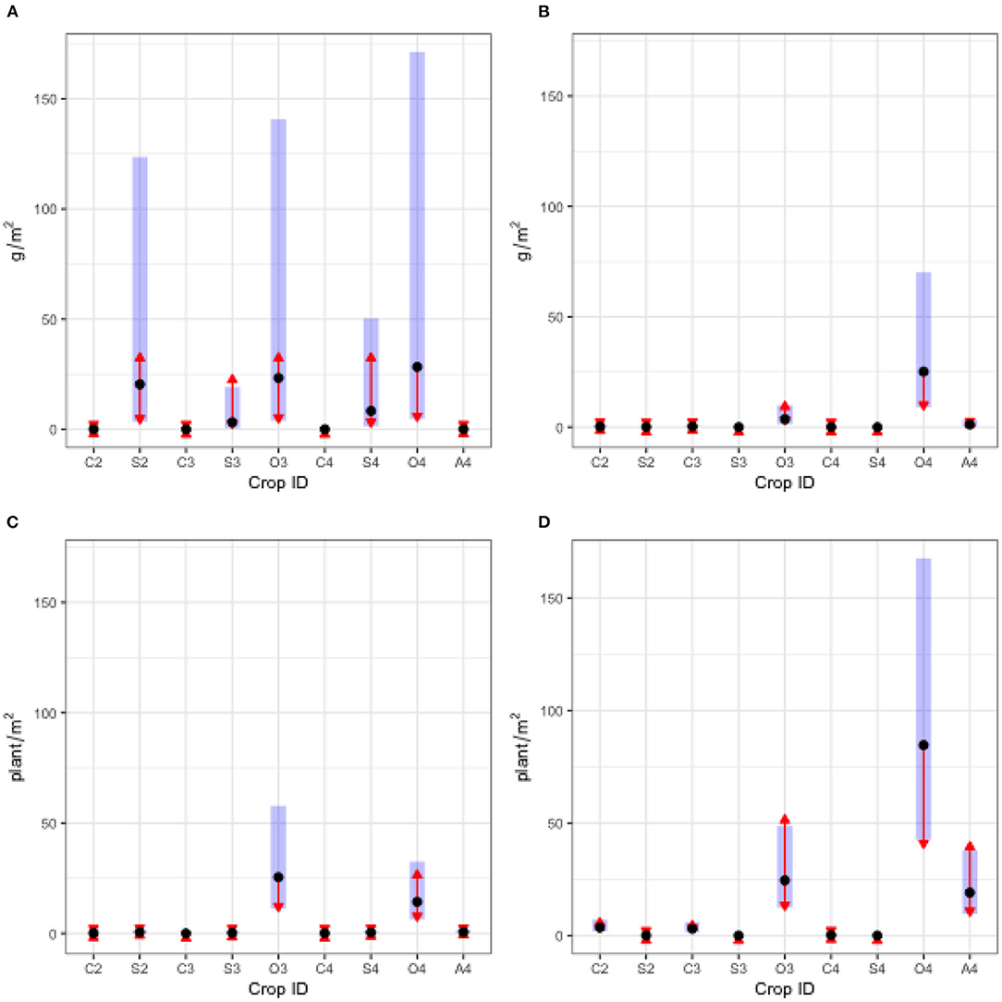
Waterhemp reproductive potential were highest and most variable in 2018 corn and oat; and most variable in 2019 oat
2018
2019
Waterhemp plant density was the
highest and most variable in oat
2018
2019
Notes:
Between soybean and oat: waterhemp density in soybean was lower but the plant mass was bigger

Slide 12
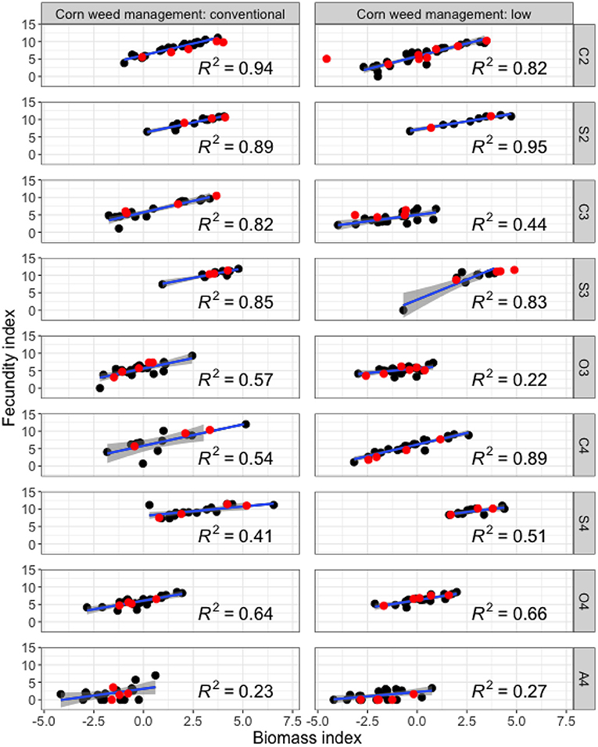
Estimation of plant fecundity from aboveground mass requires crop identity and corn weed management regime context Fecundity index = ln(seed + 1) Biomass index = ln(biomass + 0.005)
Notes:
Reproductive potential: 2018 data
Fecundity index = ln(seed + 1)
Biomass index = ln(biomass + 0.005)

Slide 13
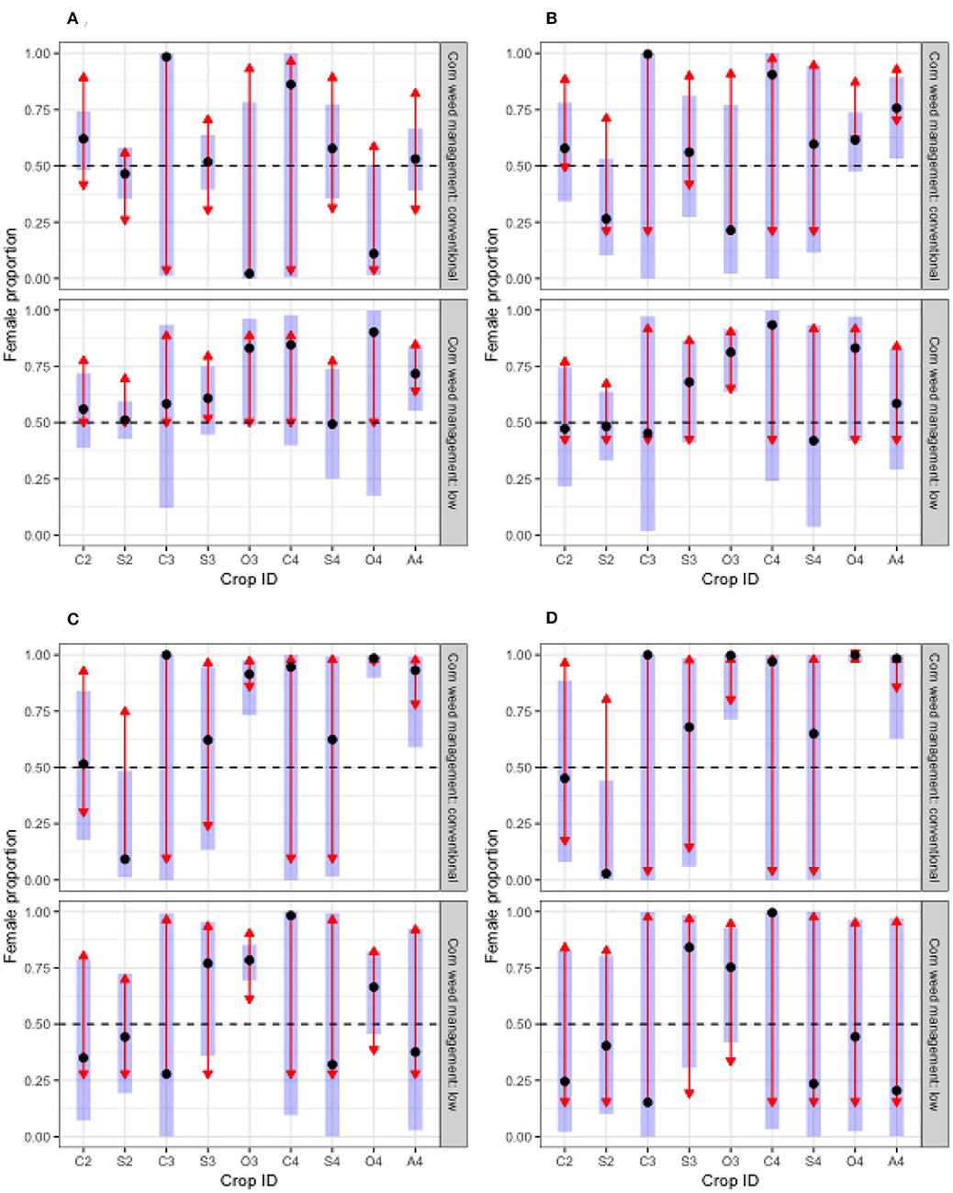
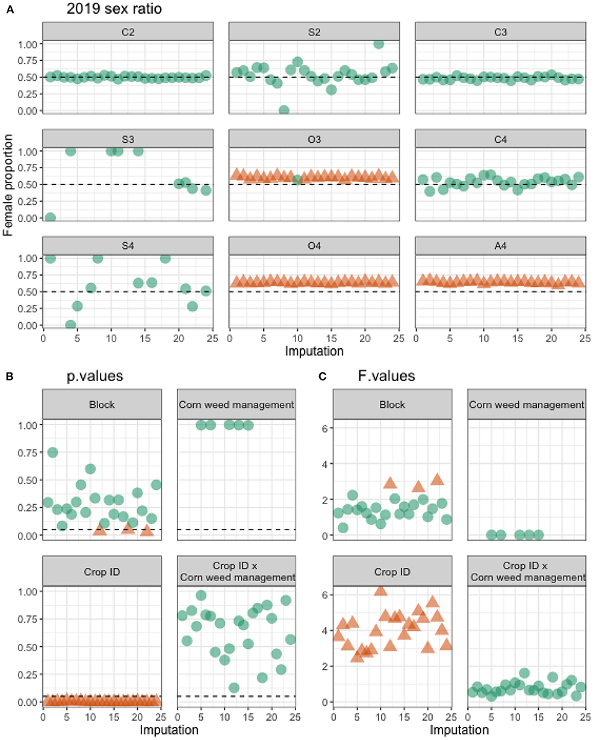
Female-biased populations might occur in oat, red clover, and alfalfa
2018 sex ratio
Notes:
Question: Does population sex ratio changes between cropping systems?
Answer: Maybe in O3
Left: 2018 sex ratio with original data
Right: 2019 sex ratio with imputed data. 2019 herbicide efficacy was very high.

Slide 14
Waterhemp population dynamics in simple versus diverse cropping systems
Questions:
How do waterhemp populations grow in different cropping systems?
What are the seed production and mature plant density thresholds in different cropping systems?
Approach: a periodic matrix model followed by simulations
Empirical data: soil seedbank density, emergence density and timing, and reproductive potential
Literature data: tillage-induced vertical redistribution (Seed Chaser), seed mortality, and seedling mortality
Notes:
An ongoing project that use structured population parameters: 2 soil depths and 6 plant cohorts.
Current observation: population growth is the most sensitive to the seedbank density and the success rate of cohort 1 establishment.

Slide 15
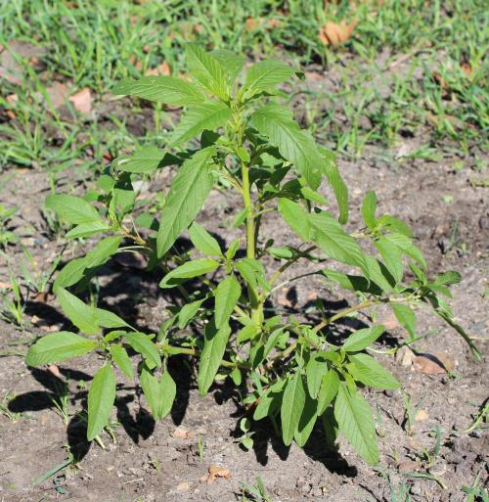
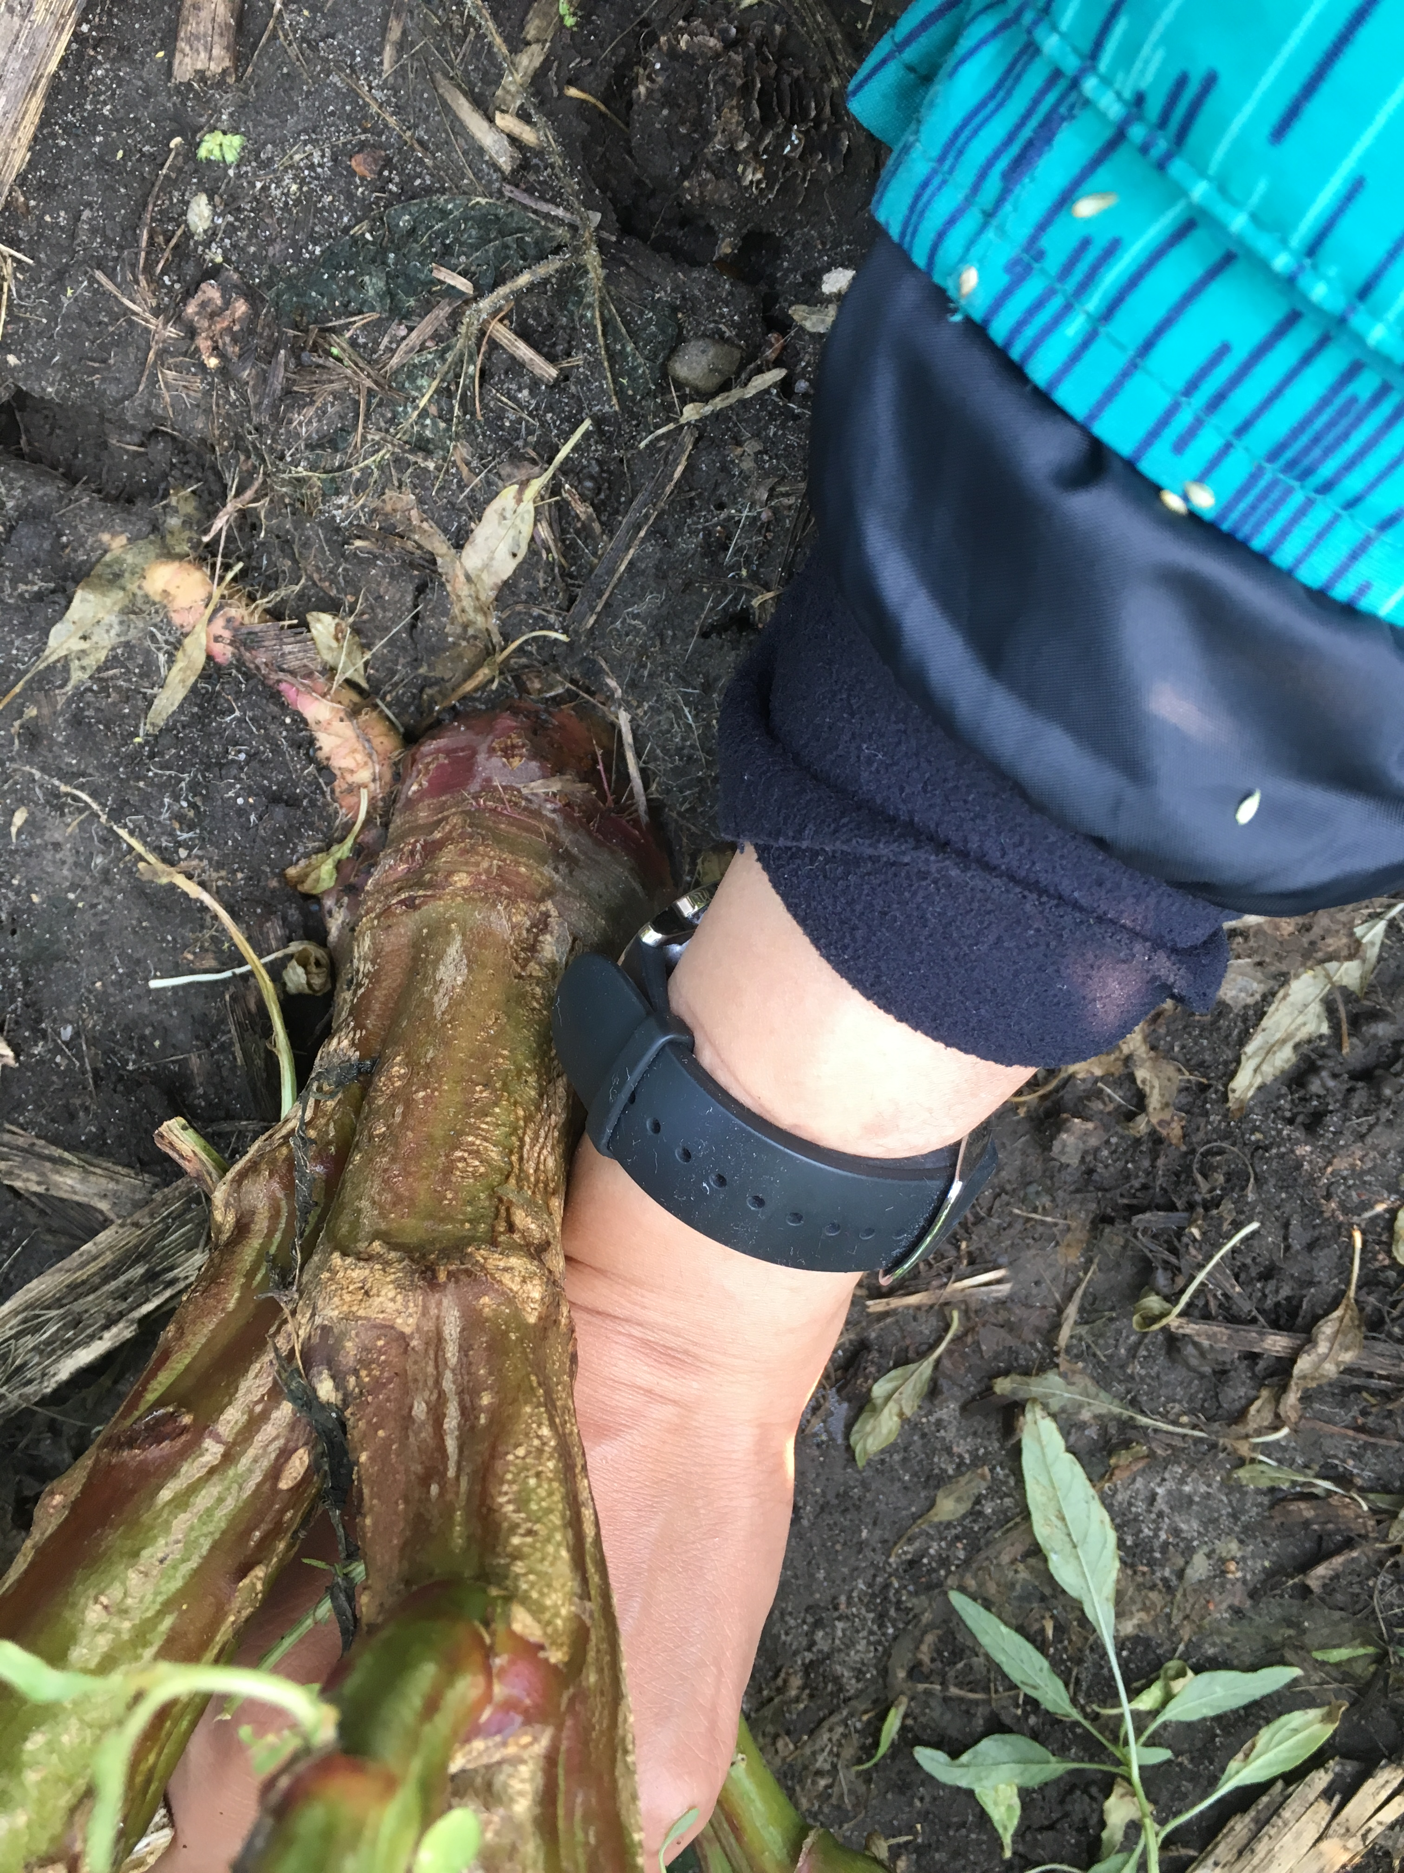
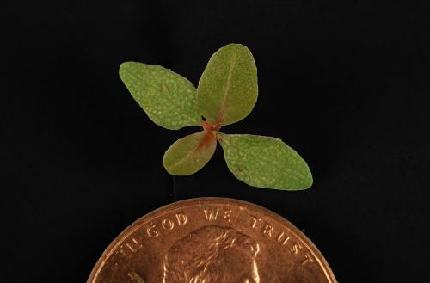
Waterhemp – an agronomically challenging weed species in row crops
Photo: Rebecca Vittetoe https://crops.extension.iastate.edu/encyclopedia/waterhemp
Photo: Huong Nguyen
Notes:
Advantageous char: high RGR, opportunistic emergence, high fecundity, quick resistance development

Slide 16
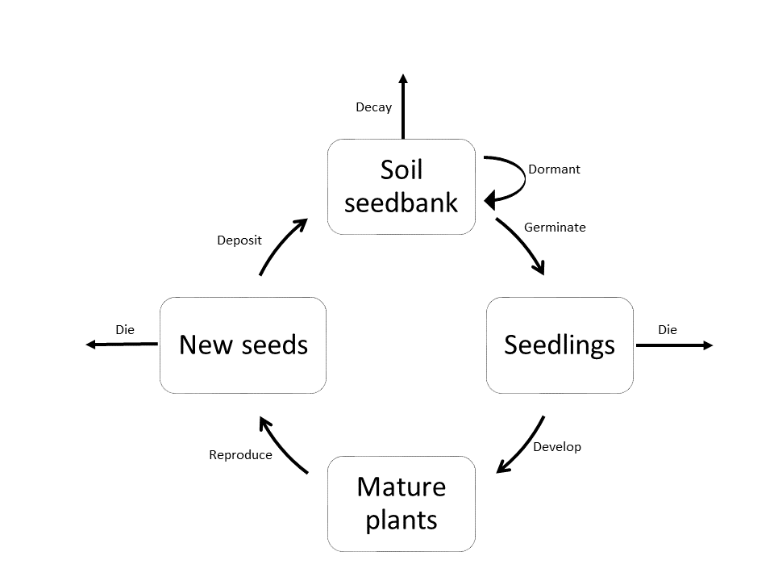
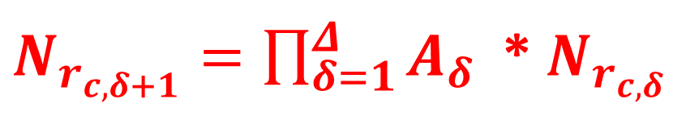

Population dynamics diagram
6 sub-annual matrices
Pre-planting tillage
Seedling recruitment/seedbank depletion
Seed and seedling survival during the crop season
Seed production
Post-harvest tillage
Overwinter seed survival
$$\left[\begin{matrix}M_{s} & M_{p,s } \\ M_{s,p} & M_{p}\end{matrix}\right]$$
$N_{r_{c,δ+1}}=\prod_{δ=1}^{Δ}{A_{δ}}$ * $N_{r_{c,δ}}$
Notes:
The inputs were organized in the most consistent way possible. For example, as many vitals from one field season as possible. Unavailable vitals are borrowed from the literature.
The subannual matrices are ordered by their occurence in a field season

Slide 17
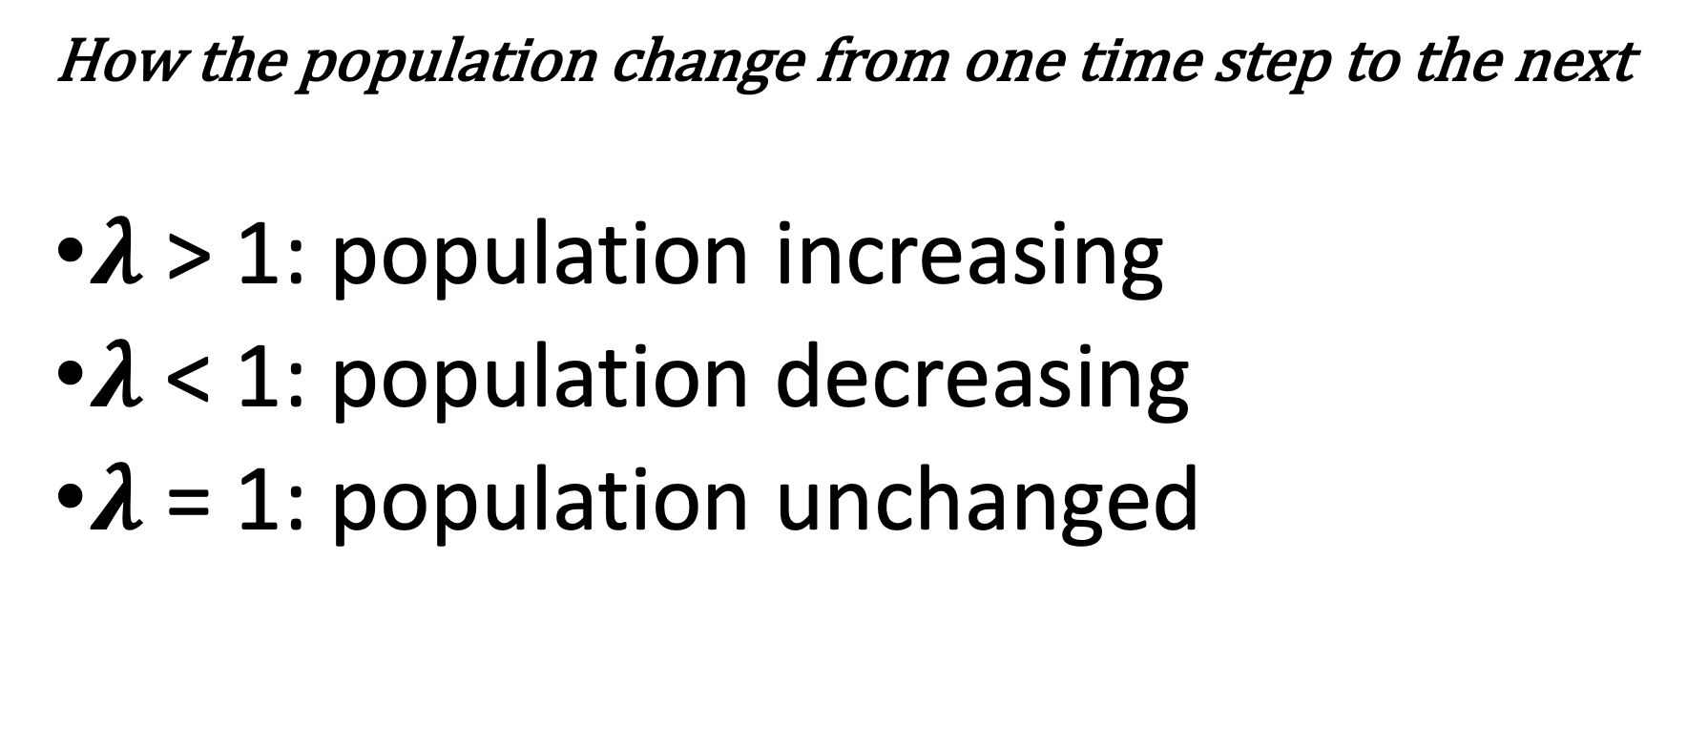

Population growth rate ($λ$)
How the population change from one time step to the next
$λ$ > 1: population increasing
$λ$ < 1: population decreasing
$λ$ = 1: population unchanged

Slide 18
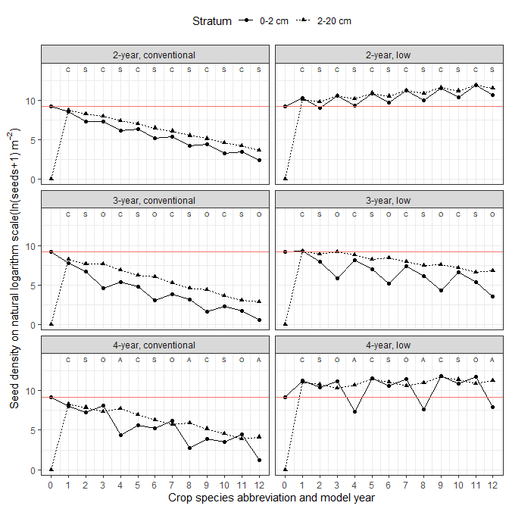
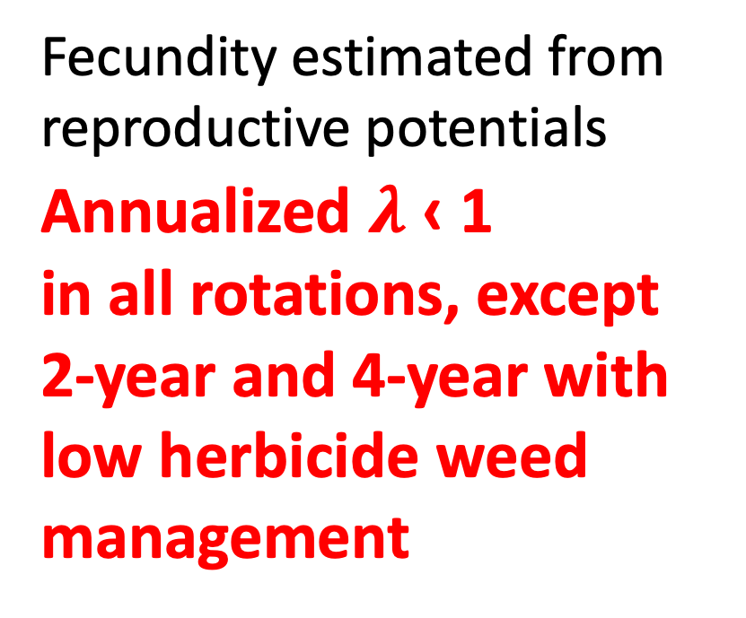
Scenario 1: high control efficacy → low fecundity
Fecundity estimated from reproductive potentials
Annualized $λ$ ‹ 1
in all rotations, except
2-year and 4-year with low herbicide weed management
Notes:
12 model years
The red line marks the seedbank size at 20 cm deep when lambda = 1.

Slide 19
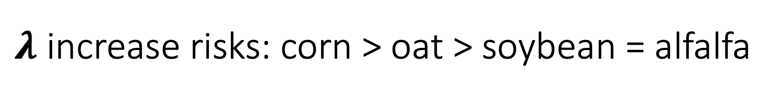
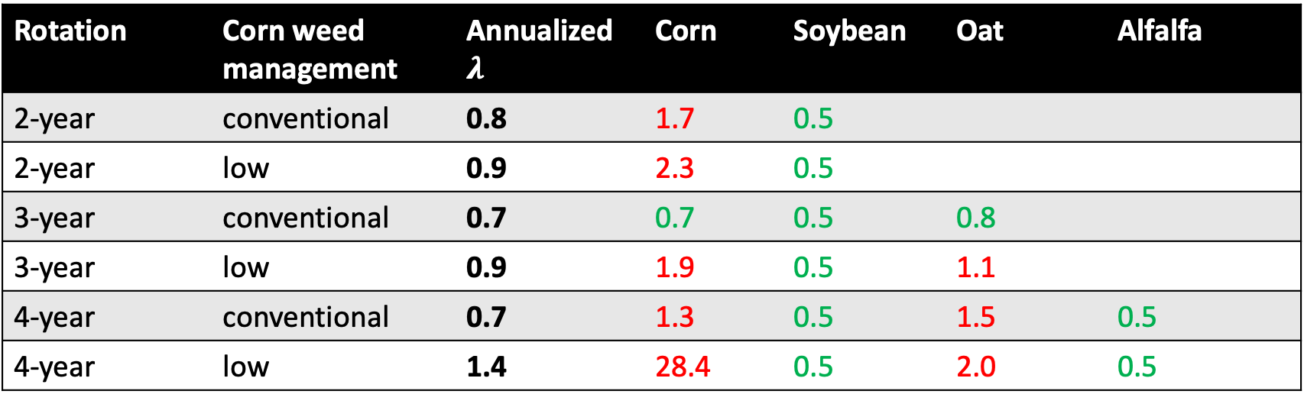
$λ$ increase risks: corn > oat > soybean = alfalfa
Rotation | Corn weed management | Annualized $λ$ | Corn | Soybean | Oat | Alfalfa
2-year | conventional | 0.8 | 1.7 | 0.5
2-year | low | 0.9 | 2.3 | 0.5
3-year | conventional | 0.7 | 0.7 | 0.5 | 0.8
3-year | low | 0.9 | 1.9 | 0.5 | 1.1
4-year | conventional | 0.7 | 1.3 | 0.5 | 1.5 | 0.5
4-year | low | 1.4 | 28.4 | 0.5 | 2.0 | 0.5
Notes:
In other words: more opportunities to decrease lambda in alfalfa and soybean.
Notice that the soybean weed control efficacy was very high, but no herbicide was applied in oat and alfalfa.
Oat could be as efficacious against waterhemp because oat is a cool-season crop. Sown early, advantage against warm ssaon crop

Slide 20
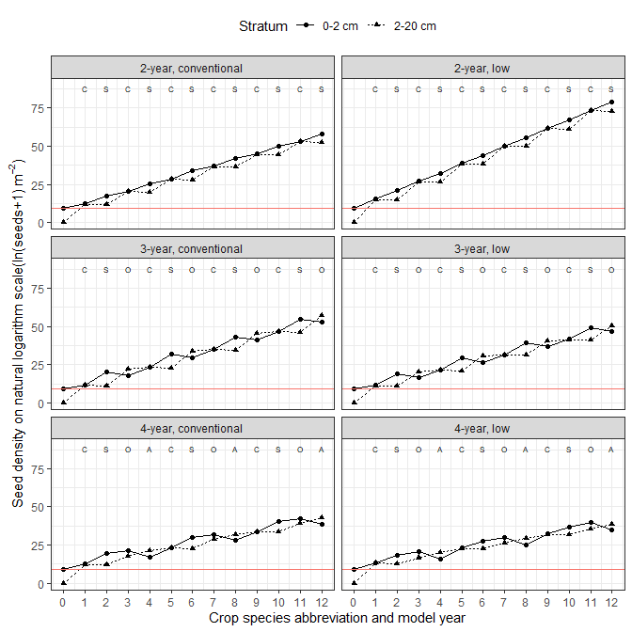
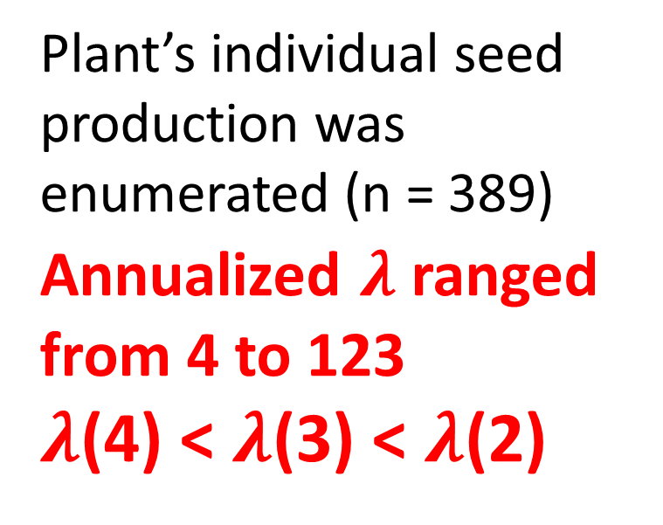
Scenario 2: low control efficacy → high fecundity
Plant’s individual seed production was enumerated (n = 389)
Annualized $λ$ ranged from 4 to 123
$λ$(4) < $λ$(3) < $λ$(2)
Notes:
12 model years

Slide 21
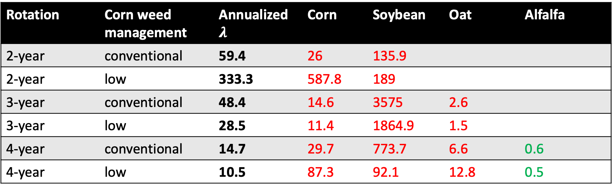
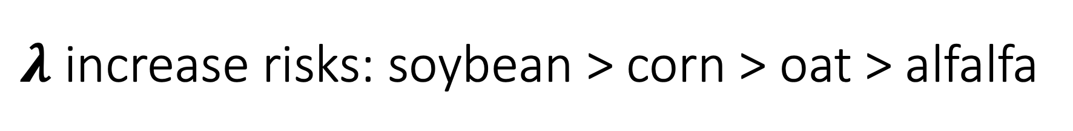
$λ$ increase risks: soybean > corn > oat > alfalfa
Rotation | Corn weed management | Annualized $λ$ | Corn | Soybean | Oat | Alfalfa
2-year | conventional | 59.4 | 26 | 135.9
2-year | low | 333.3 | 587.8 | 189
3-year | conventional | 48.4 | 14.6 | 3575 | 2.6
3-year | low | 28.5 | 11.4 | 1864.9 | 1.5
4-year | conventional | 14.7 | 29.7 | 773.7 | 6.6 | 0.6
4-year | low | 10.5 | 87.3 | 92.1 | 12.8 | 0.5
Notes:
Low control efficacy in both corn and soybean
Common problem: oat did not establish well → gaps between rows AND hail-damage soon before harvest

Slide 22
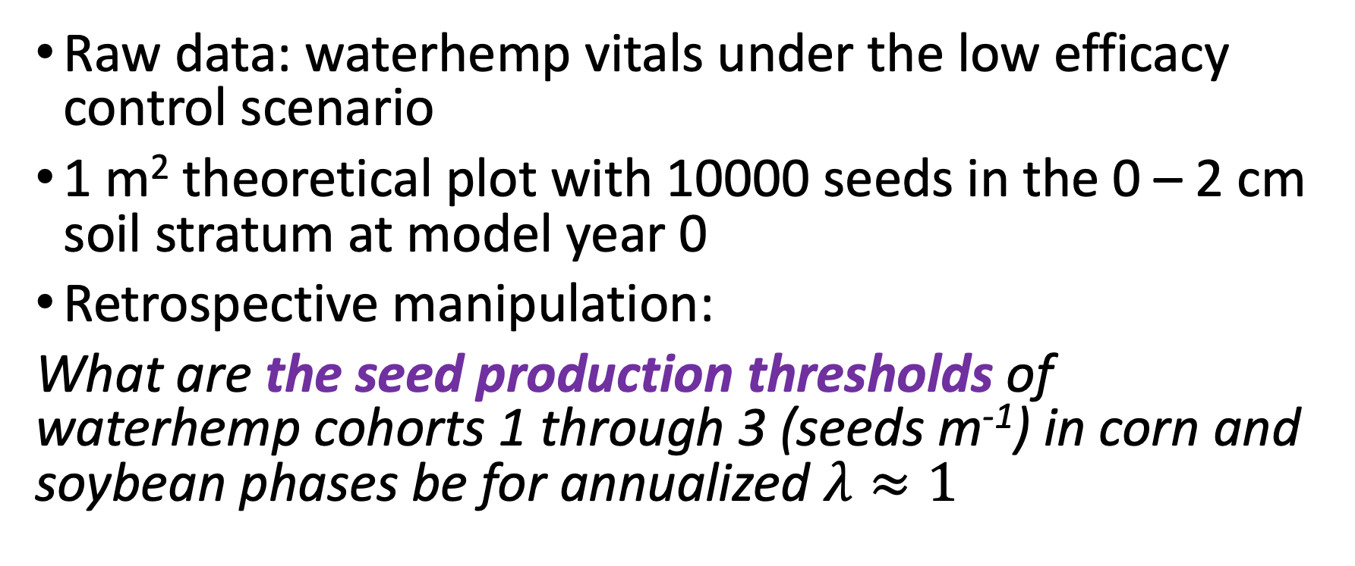
Seed production threshold simulation
Raw data: waterhemp vitals under the low efficacy control scenario
1 m² theoretical plot with 10000 seeds in the 0 – 2 cm soil stratum at model year 0
Retrospective manipulation:
What are the seed production thresholds of waterhemp cohorts 1 through 3 (seeds m⁻¹) in corn and soybean phases be for annualized $λ≈1$
Notes:
Target = first 3 cohorts because they are more likely exposed to control measures: herbicide and interrow cultivation
Given the mature plant density (plants m⁻²) in the population trajectories,

Slide 23
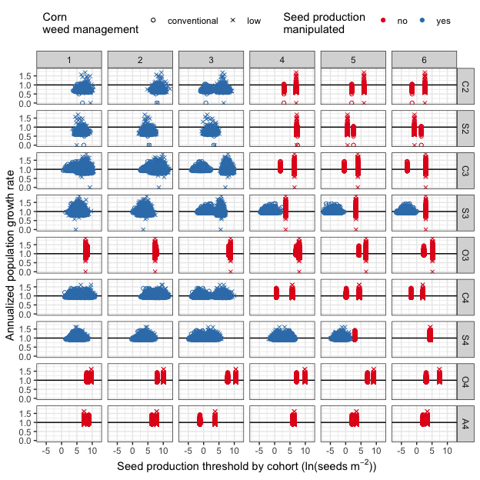
Seed production thresholds
Corn: 4-year > 3-year > 2-year
Soybean: 2-year > 3-year > 4-year
Oat: 3-year > 4-year
Notes:
Emergence success rates: PRE < cool-season crop < POST

Slide 24
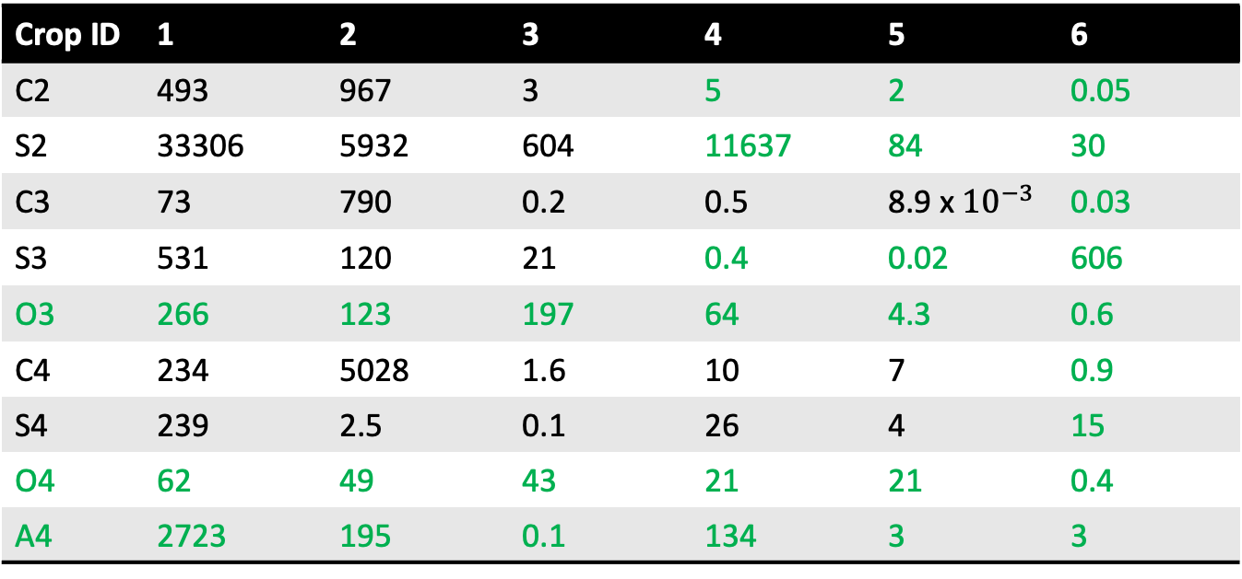
Control efficacy required: 2-year > 4-year > 3-year
Crop ID | 1 | 2 | 3 | 4 | 5 | 6
C2 | 493 | 967 | 3 | 5 | 2 | 0.05
S2 | 33306 | 5932 | 604 | 11637 | 84 | 30
C3 | 73 | 790 | 0.2 | 0.5 | 8.9 x ${10}^{−3}$ | 0.03
S3 | 531 | 120 | 21 | 0.4 | 0.02 | 606
O3 | 266 | 123 | 197 | 64 | 4.3 | 0.6
C4 | 234 | 5028 | 1.6 | 10 | 7 | 0.9
S4 | 239 | 2.5 | 0.1 | 26 | 4 | 15
O4 | 62 | 49 | 43 | 21 | 21 | 0.4
A4 | 2723 | 195 | 0.1 | 134 | 3 | 3
Conventional corn weed management
Notes:
In terns of seeds production …
Green numbers: not manipulated

Slide 25
Control efficacy required: 3-year > 2-year > 4-year
Crop ID | 1 | 2 | 3 | 4 | 5 | 6
C2 | 253 | 701 | 448 | 61 | 22 | 0.8
S2 | 791 | 195 | 83 | 1007 | 1.4 | 0.4
C3 | 245 | 3759 | 371 | 96 | 8 | 3
S3 | 194 | 144 | 709 | 81 | 65 | 42
O3 | 72 | 46 | 196 | 87 | 23 | 5
C4 | 1646 | 5567 | 148 | 5 | 51 | 7
S4 | 71 | 18 | 0.6 | 0.4 | 0.03 | 9
O4 | 65 | 99 | 147 | 75 | 38 | 6
A4 | 72 | 125 | 2 | 29 | 1.6 | 1.5
Low herbicide corn weed management
Notes:
In terns of seeds production …
Green numbers: not manipulated

Slide 26
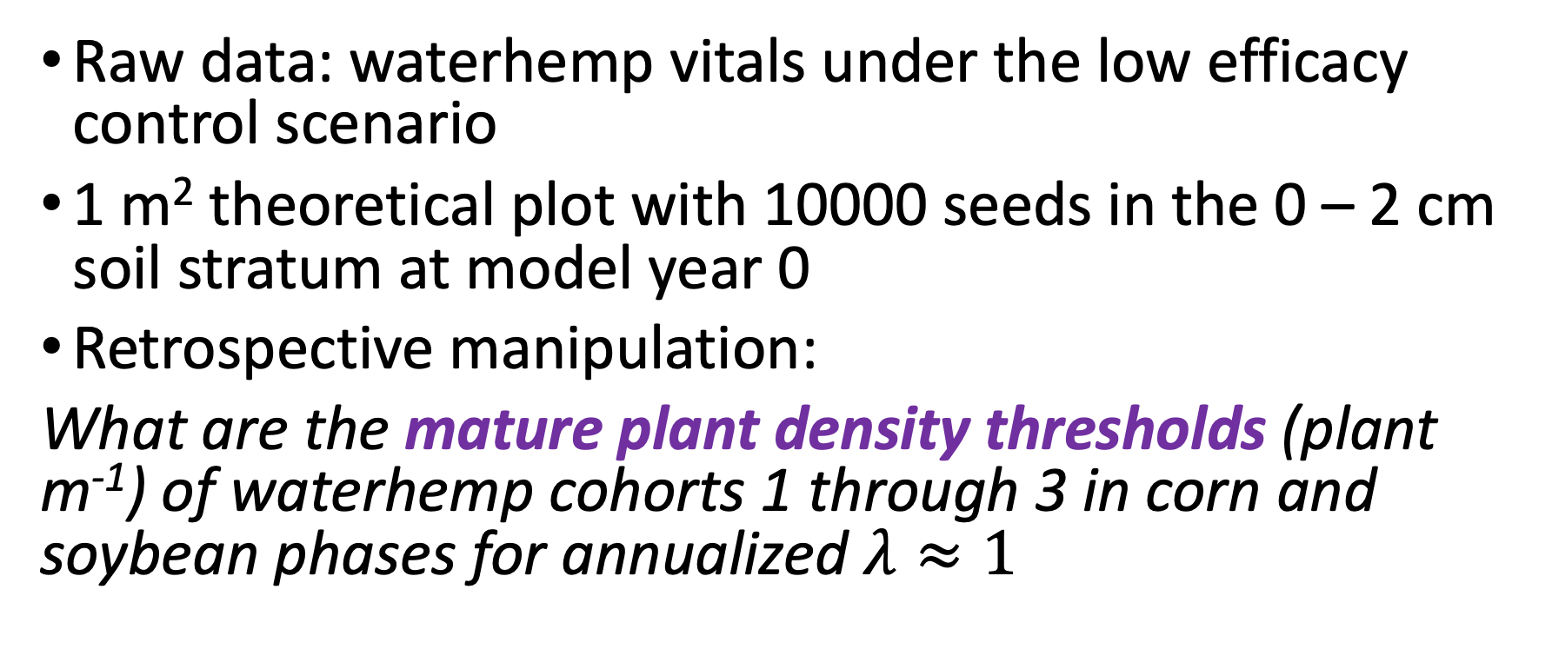
Mature plant density threshold simulation
Raw data: waterhemp vitals under the low efficacy control scenario
1 m² theoretical plot with 10000 seeds in the 0 – 2 cm soil stratum at model year 0
Retrospective manipulation:
What are the mature plant density thresholds (plant m⁻¹) of waterhemp cohorts 1 through 3 in corn and soybean phases for annualized $λ≈1$
Notes:
Given the mature plants’ reproductive potential in the population trajectories, w

Slide 27
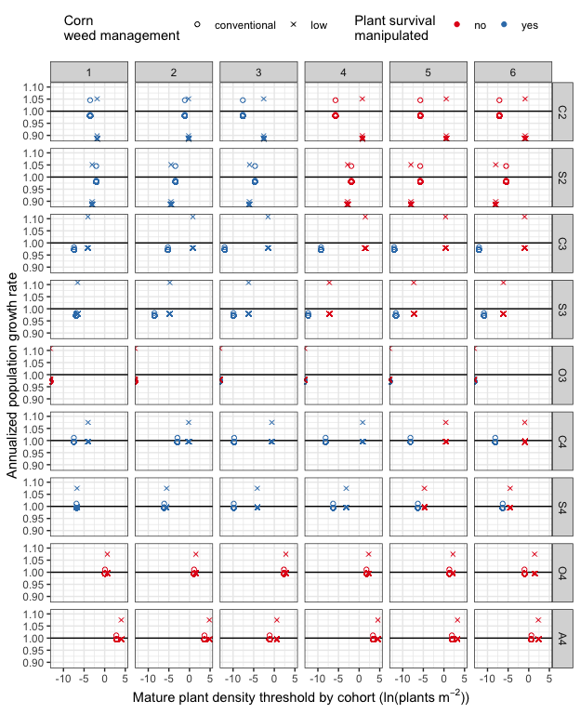
Mature plant density thresholds
Corn: 4-year > 2-year > 3-year
Soybean: 2-year > 4-year > 3-year
Oat: 3-year > 4-year

Slide 28
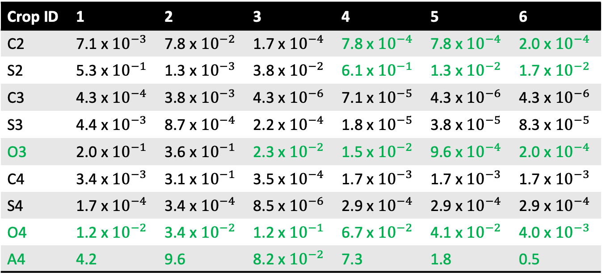
Control efficacy required: 3-year > 4-year > 2-year
Crop ID | 1 | 2 | 3 | 4 | 5 | 6
C2 | 7.1 x ${10}^{−3}$ | 7.8 x ${10}^{−2}$ | 1.7 x ${10}^{−4}$ | 7.8 x ${10}^{−4}$ | 7.8 x ${10}^{−4}$ | 2.0 x ${10}^{−4}$
S2 | 5.3 x ${10}^{−1}$ | 1.3 x ${10}^{−3}$ | 3.8 x ${10}^{−2}$ | 6.1 x ${10}^{−1}$ | 1.3 x ${10}^{−2}$ | 1.7 x ${10}^{−2}$
C3 | 4.3 x ${10}^{−4}$ | 3.8 x ${10}^{−3}$ | 4.3 x ${10}^{−6}$ | 7.1 x ${10}^{−5}$ | 4.3 x ${10}^{−6}$ | 4.3 x ${10}^{−6}$
S3 | 4.4 x ${10}^{−3}$ | 8.7 x ${10}^{−4}$ | 2.2 x ${10}^{−4}$ | 1.8 x ${10}^{−5}$ | 3.8 x ${10}^{−5}$ | 8.3 x ${10}^{−5}$
O3 | 2.0 x ${10}^{−1}$ | 3.6 x ${10}^{−1}$ | 2.3 x ${10}^{−2}$ | 1.5 x ${10}^{−2}$ | 9.6 x ${10}^{−4}$ | 2.0 x ${10}^{−4}$
C4 | 3.4 x ${10}^{−3}$ | 3.1 x ${10}^{−1}$ | 3.5 x ${10}^{−4}$ | 1.7 x ${10}^{−3}$ | 1.7 x ${10}^{−3}$ | 1.7 x ${10}^{−3}$
S4 | 1.7 x ${10}^{−4}$ | 3.4 x ${10}^{−4}$ | 8.5 x ${10}^{−6}$ | 2.9 x ${10}^{−4}$ | 2.9 x ${10}^{−4}$ | 2.9 x ${10}^{−4}$
O4 | 1.2 x ${10}^{−2}$ | 3.4 x ${10}^{−2}$ | 1.2 x ${10}^{−1}$ | 6.7 x ${10}^{−2}$ | 4.1 x ${10}^{−2}$ | 4.0 x ${10}^{−3}$
A4 | 4.2 | 9.6 | 8.2 x ${10}^{−2}$ | 7.3 | 1.8 | 0.5
Conventional corn weed management
Notes:
Green numbers: not manipulated
O3: 99.99% efficacy required;
If higher control was achieved in corn and soybean, the current control efficacy levels in O4 and A4 are acceptable

Slide 29
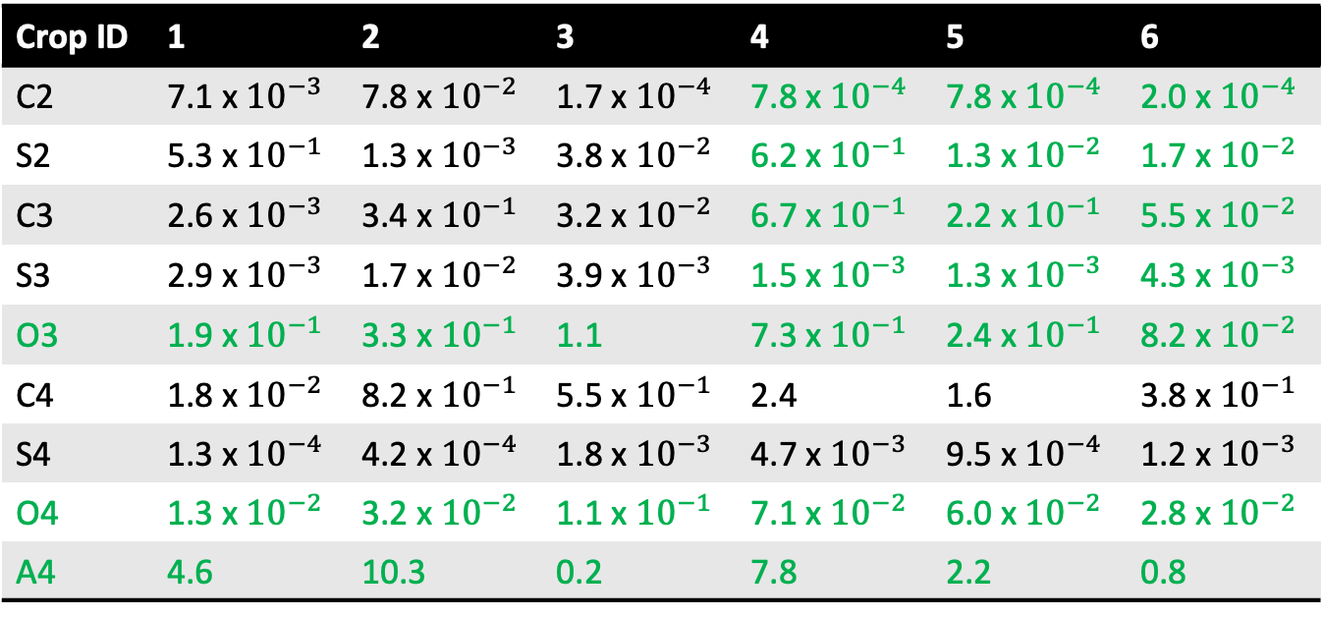
Similar control efficacy required
Crop ID | 1 | 2 | 3 | 4 | 5 | 6
C2 | 7.1 x ${10}^{−3}$ | 7.8 x ${10}^{−2}$ | 1.7 x ${10}^{−4}$ | 7.8 x ${10}^{−4}$ | 7.8 x ${10}^{−4}$ | 2.0 x ${10}^{−4}$
S2 | 5.3 x ${10}^{−1}$ | 1.3 x ${10}^{−3}$ | 3.8 x ${10}^{−2}$ | 6.2 x ${10}^{−1}$ | 1.3 x ${10}^{−2}$ | 1.7 x ${10}^{−2}$
C3 | 2.6 x ${10}^{−3}$ | 3.4 x ${10}^{−1}$ | 3.2 x ${10}^{−2}$ | 6.7 x ${10}^{−1}$ | 2.2 x ${10}^{−1}$ | 5.5 x ${10}^{−2}$
S3 | 2.9 x ${10}^{−3}$ | 1.7 x ${10}^{−2}$ | 3.9 x ${10}^{−3}$ | 1.5 x ${10}^{−3}$ | 1.3 x ${10}^{−3}$ | 4.3 x ${10}^{−3}$
O3 | 1.9 x ${10}^{−1}$ | 3.3 x ${10}^{−1}$ | 1.1 | 7.3 x ${10}^{−1}$ | 2.4 x ${10}^{−1}$ | 8.2 x ${10}^{−2}$
C4 | 1.8 x ${10}^{−2}$ | 8.2 x ${10}^{−1}$ | 5.5 x ${10}^{−1}$ | 2.4 | 1.6 | 3.8 x ${10}^{−1}$
S4 | 1.3 x ${10}^{−4}$ | 4.2 x ${10}^{−4}$ | 1.8 x ${10}^{−3}$ | 4.7 x ${10}^{−3}$ | 9.5 x ${10}^{−4}$ | 1.2 x ${10}^{−3}$
O4 | 1.3 x ${10}^{−2}$ | 3.2 x ${10}^{−2}$ | 1.1 x ${10}^{−1}$ | 7.1 x ${10}^{−2}$ | 6.0 x ${10}^{−2}$ | 2.8 x ${10}^{−2}$
A4 | 4.6 | 10.3 | 0.2 | 7.8 | 2.2 | 0.8
Low herbicide corn weed management
Notes:
Green numbers: not manipulated
Raw projection: lower reproductive potential in low herbicide wm but higher pl density
No additional control efficacy was required in O and A

Slide 30
General conclusions
Crop identity was the most influential factor in the individual, population, and community dynamics
No yield decline was found in any crop in coincidence with higher weed community abundance
More diverse and species-rich weed communities were found in more diverse cropping systems
Lower evenness index of weed community was recorded in the more diverse cropping systems, but more of the rarer weed species were found and the relative abundance of competitive weed species was more even

Slide 31
General conclusions (continued)
Waterhemp's reproductive potential was reduced in the cool-season crops, and thus, its population growth rates were reduced.
Oat and alfalfa crop environments provide fairly reliable opportunities to reduce waterhemp seedbank density
Extending the 2-year rotation of warm-season crops with two years of cool-season crops could be effective in stabilizing waterhemp soil seedbank

Slide 32
Shortcomings and future research
Unclear relationship between individual plant size effects on weed community evenness
Unrealistic success rates from seedling to mature plant -> more focused field experiment for oat, red clover, and alfalfa crop environments
Establish waterhemp seedling control plans to eliminate highly productive mature plants from the seed production and plant density thresholds

Slide 33
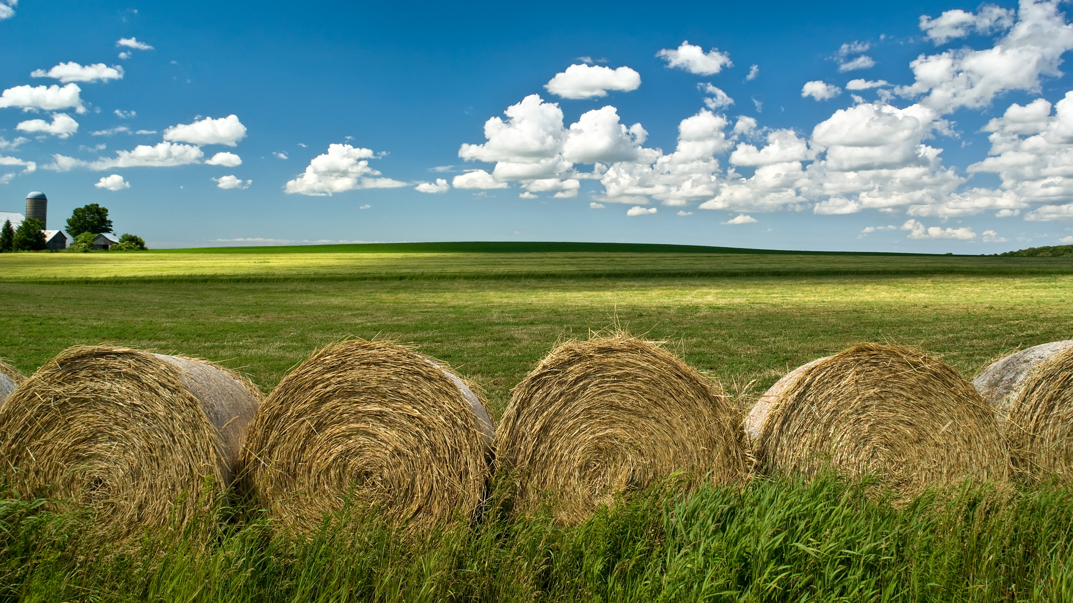
Thank you!

